Slide 1

EE2 Circuits and Systems
Problem Class 3
Lab 1 & 2 Explained
Prof Peter Y. K. Cheung
Imperial College London
URL: www.ee.ic.ac.uk/pcheung/teaching/EE2_CAS/
E-mail: p.cheung@imperial.ac.uk
Notes:
Welcome to this first course you will take on electronic engineering. I am looking forward to teaching such a course to Design Engineering students for a long time. It presents a personal challenge: how to select and teach from a vast amount of materials we normally teach to first year EE students to you in a quarter of the available time? Even more challenging is: how to ensure that you retain what you learn in electronics for years to come, and only encounter this topic rarely during this period? I am going to give this a try.
Because this is a new course and I am giving it for the first time, I would welcome feedback from you in any form.
All my teaching materials including lecture slides with notes, laboratory work and tutorial problem sheets can be found on the course webpage shown here. Furthermore, all lectures will be recorded with Panopto.

Slide 2
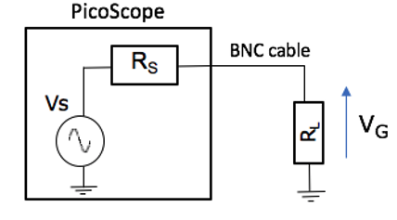



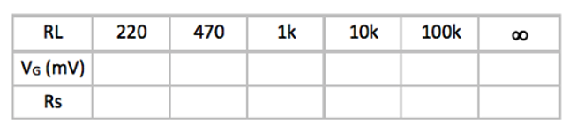
Task 1 – Output impedance of PicoScope SigGen
Rs
Actual
40
Ideal – constant Rs
Iout (output current)

Slide 3
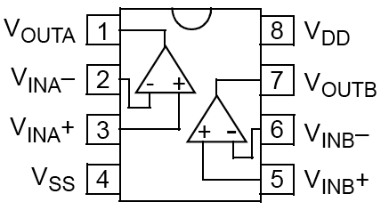
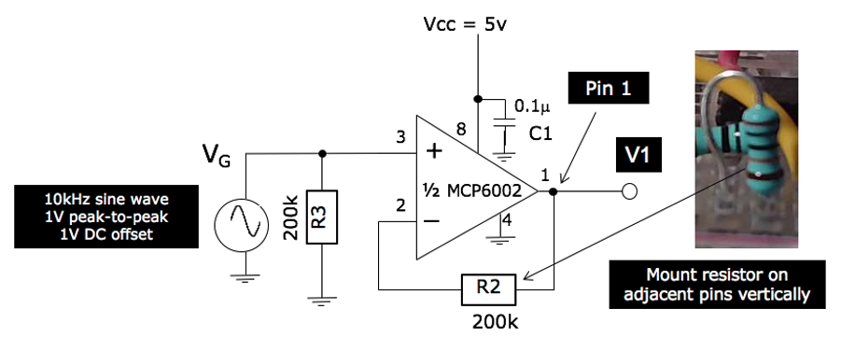
Task 2 – Using a Unity Gain Amplifier (2)
Add R3 (200k) – makes no difference, but ready for Task 3

Slide 4
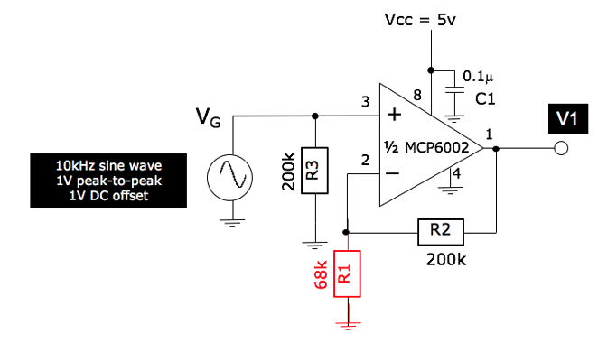
Task 3 – x4 Amplifier Failure (1)
Add R4. The gain of the amplifier should be x4.
However, you will see that V₁ shows a sine wave with top of it “clipped”.

Slide 5
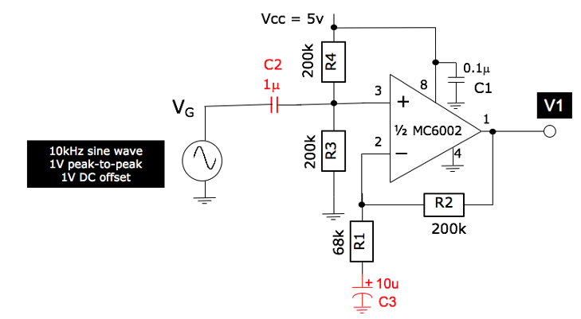
Task 3 – x4 Amplifier Success (1)
Add C2 and C3. This will now work. Why?

Slide 6
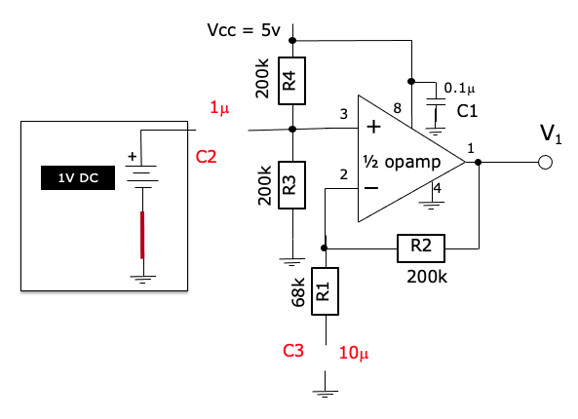
Task 3 – x4 Amplifier Success (2)
Consider what happens at DC source (principle of superposition):
C2 is open-circuit, so 2.5V dc is blocked by C2. Instead, V+ is now at 2.5V because of R1 and R2 (voltage divider).
C3 is open-circuit. Therefore the op-amp is now a x1 amplifier as in Task 2.
2.5V
2.5V
x1

Slide 7
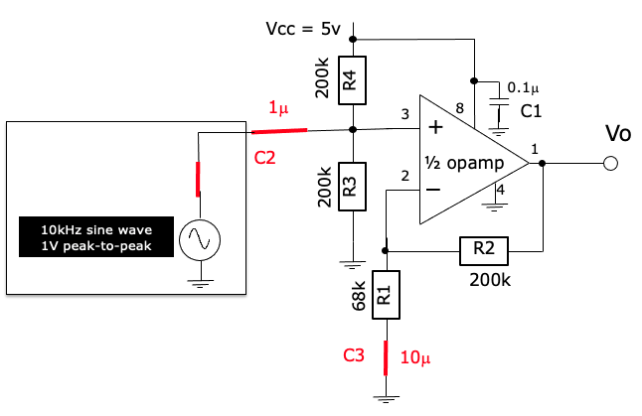
Task 3 – x4 Amplifier Success (3)
Consider what happens at high frequency (e.g. 10kHz sine wave):
C2 is short-circuit, so V_{G} goes directly to V+.
C3 is short-circuit. Therefore the op-amp is now a x4 amplifier

Slide 8
Task 4 – Better bias circuit (1)
Bias voltage at pin 3 is poor because ……

Slide 9
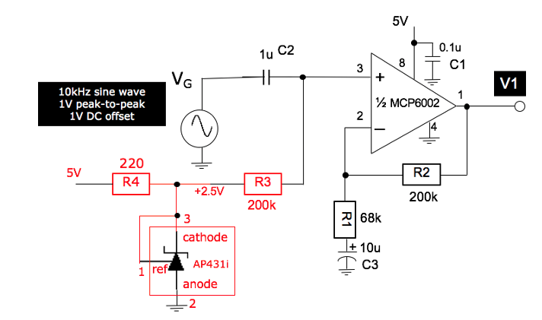
Task 4 – Better bias circuit (2)
Replace resistor divider bias circuit with proper voltage reference
Why is R3 necessary?
What is the loading seen by the PicoScope signal generator?

Slide 10
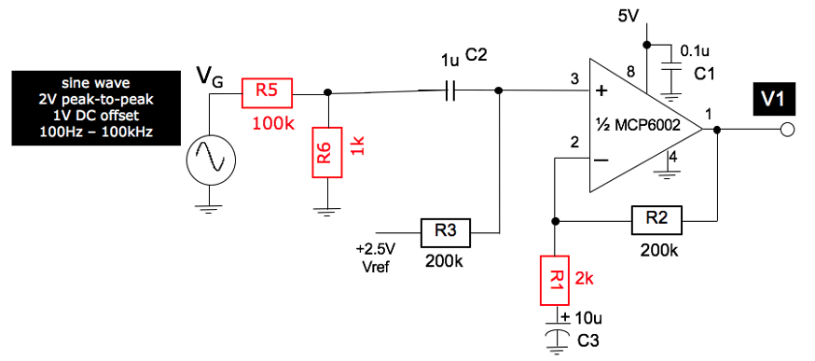
Task 5 – Large Gain amplifier failure
Replace R1 with 2k ohm resistor. Gain = 1 + R2/R1 = 101

Slide 11
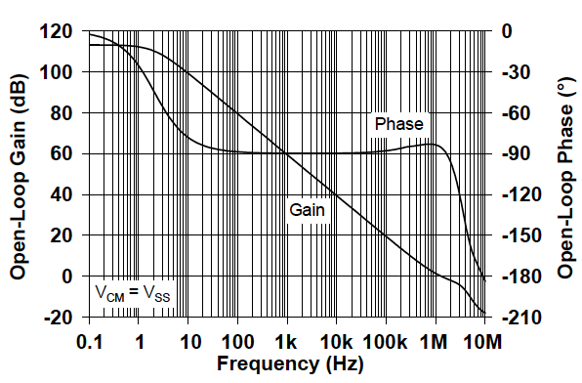
Task 5 – Gain-Bandwidth Product limit
Gain drops by 20dB /decade 1st order
112dB gain up to 2Hz
Gain-Bandwidth Product (GBP) = Gain x frequency
MCP6001
GBP for MCP6001 is 1MHz
Gain = 0dB at around 1MHz
Notes:
Although the open-loop gain of the MCP6001 at DC (or 0Hz) is very high (at over 100,000), this gain drops off very quickly as the signal frequency is beyond 2Hz. Beyond 2Hz, the gain falls off at a rate of -20dB/decade (i.e. drops by a factor 10 as signal frequency goes up by a factor of 10).
As we reach around 1MHz, the open-loop gain is only 1. That means at this frequency, the op-amp, without feedback, will not behave like an amplifier any more.
The frequency at which the gain drops to 1 is known as the Gain-Bandwith Product (GBP). Notice that beween 2Hz and 1MHz, the open-loop gain and the signal frequency, when multiplied together, is a constant = 10⁶.
In other words, given the maximum frequency of your signal that you need to amplify, the GBP tells you how much gain you can obtain from this op-amp. For example, If your maximum signal frequency is 10kHz, you will not be ablet o design an amplifier that gives a gain of at most 40dB (x100), actually will be somewhat lower than x100. You will be exploring this in Lab 1.
There are op-amps designed to have much higher GBP than this is one. However, the higher the GBP, the more likely the op-amp will oscillate (i.e. go unstable). For these op-amp to work, one would need to design the PCB carefully to avoid unexpected feedback path for signals.

Slide 12
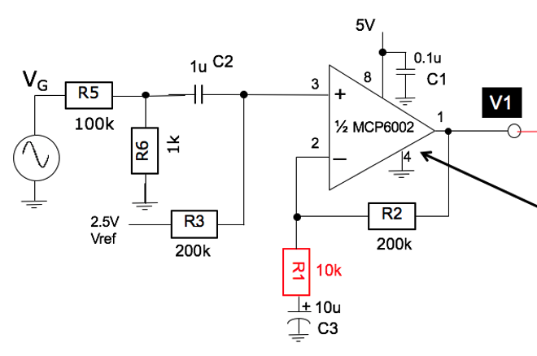
Task 6 – High gain amplifier in 2 stages (1)
Stage 1: non-inverting amplifier with GAIN = 21
Replace R1 with a 10k ohm resistor. Now gain is x21

Slide 13
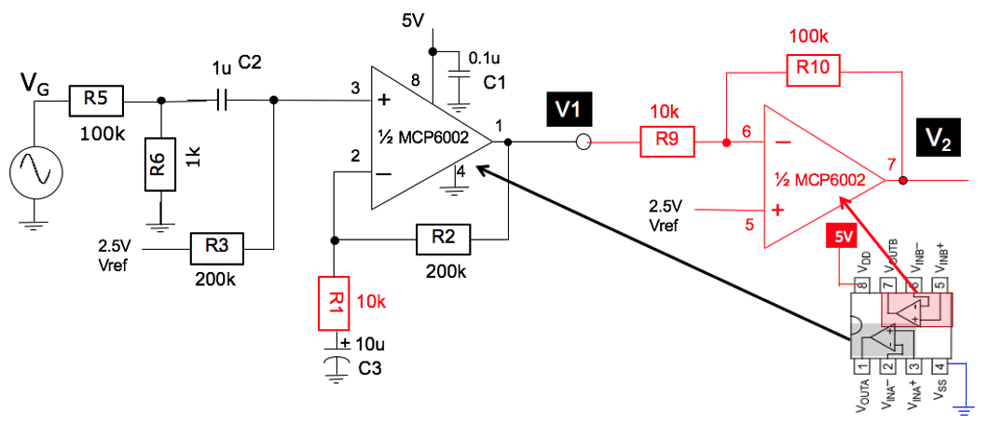
Task 6 – x210 amplifier in 2 stages (2)
Stage 2: inverting amplifier with GAIN = -10 (circuit in RED)
Now check Vo1 and Vo2
Topic 11 slide 8

Slide 14
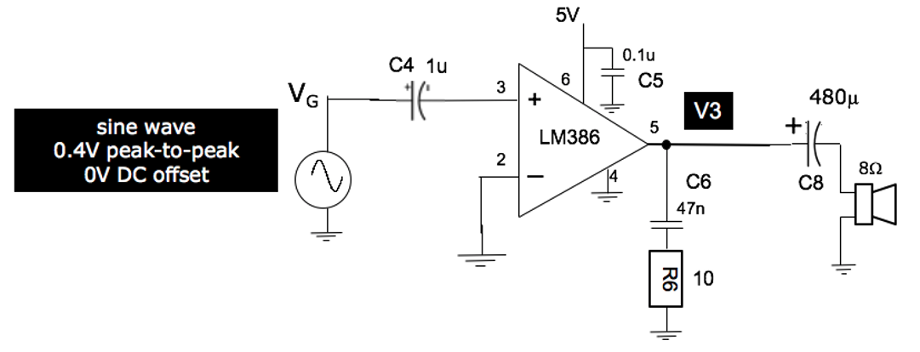
Task 7 – Audio Amplifier for 8 ohm speaker
Op-amp only can only deliver at most 20mA current at its output
Need special amplifier to drive 8 ohm speaker
Use special amplifier for this purpose

Slide 15
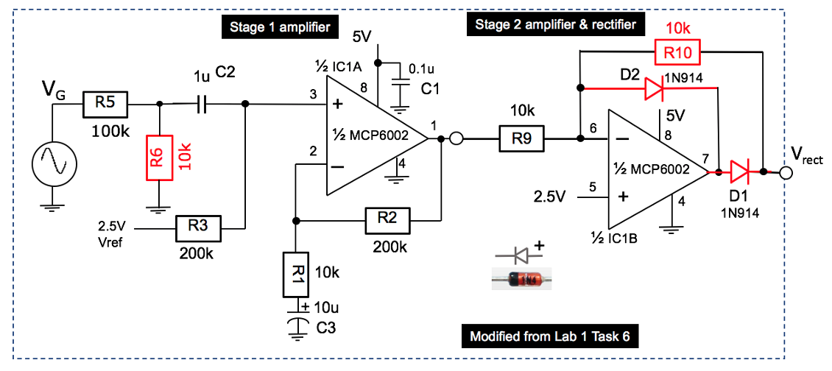
Lab 2 Task 1 – Half-wave Rectifier
Good half-wave rectifier

Slide 16
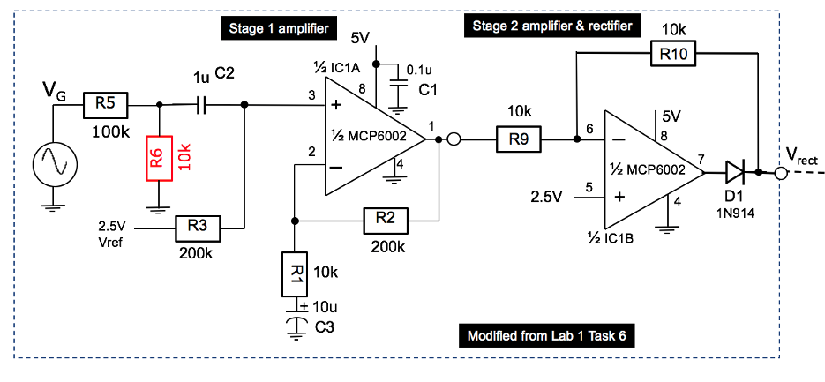
Lab 2 Task 1 – Full-wave rectifier
Poor full-wave rectifier

Slide 17
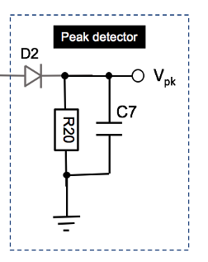
Lab 2 Task 1 – Peak detection
Peak detecting

Slide 18
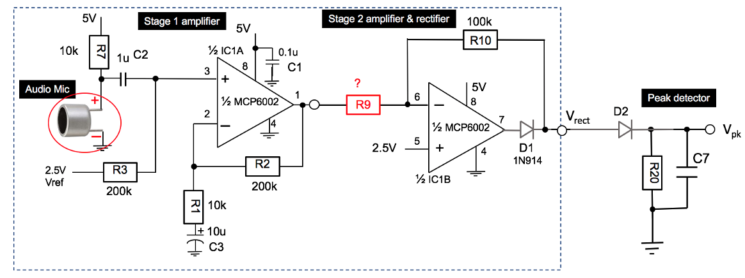
Lab 2 Task 1 – Sound level detection
R9 – estimate or measure, not easy to calculate

Slide 19
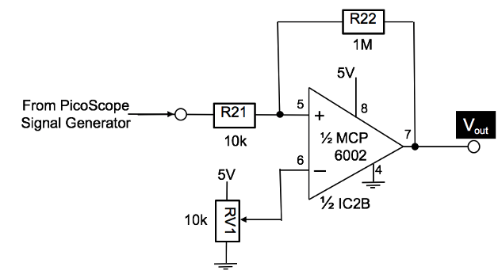
Lab 2 Task 2 – Comparator with hysteresis

Slide 20
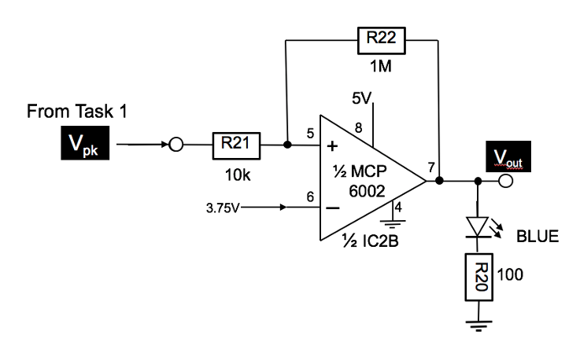
Lab 2 Task 2 – Comparator to detect sound

Slide 21
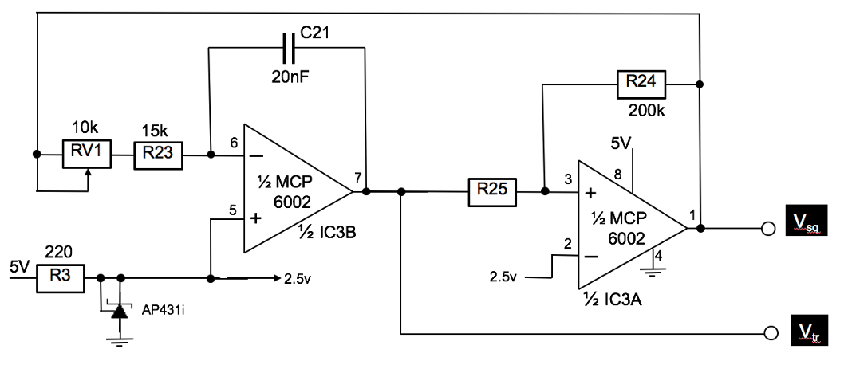
Lab 2 Task 3 – Function Generator

Slide 22
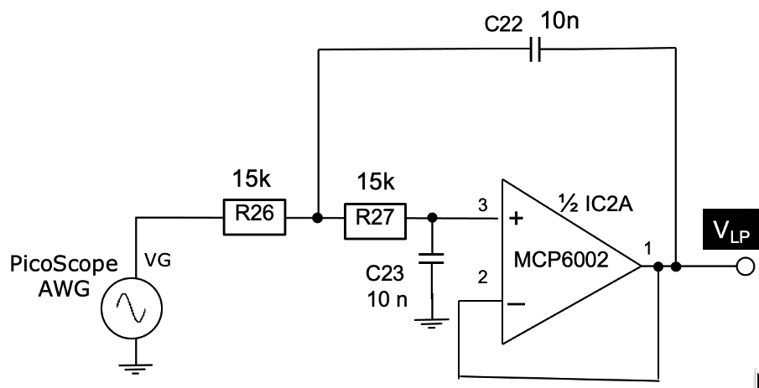
Lab 2 Task 4 – Lowpass filter

Slide 23
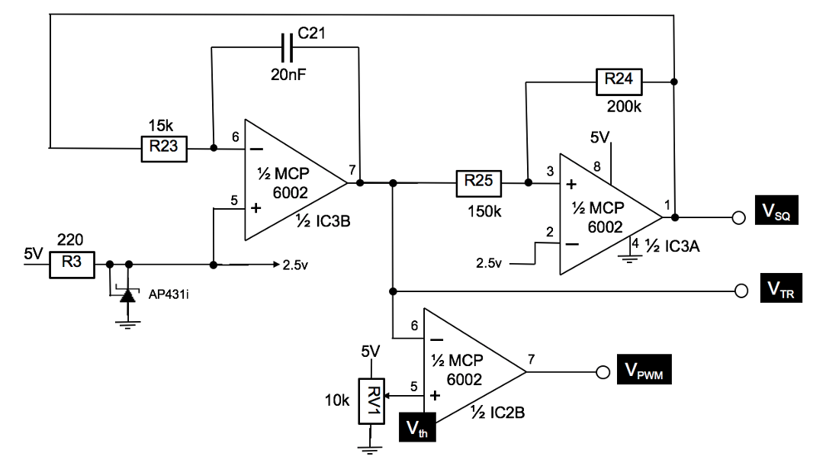
Lab 2 Task 5 – Pulse-width modulator

Slide 24
Lab 2 Task 5 – Pulse-width modulator

